Slide 1
Enhance Marketing Campaign: Optimizing Certificate of Deposit (CD) Subscriptions with 2-Fold Strategies of Segmentation and Classification
Nawaraj Paudel, PhD (Quantitative Modeling of Materials)
Data Scientist and ML Engineer

Slide 2
CDs offer high return with no capital risk
Market Comparison
CDs: Secure returns, appealing when federal interest rates are high
S&P 500: Higher returns (over 7%) but with market volatility and risk of capital loss
Inflation: CD yield of 6% helps stay ahead of average inflation (over 2%)
Certificate of Deposits (CDs)
Lock-up period: 1 month to several years
Higher interest rates than traditional savings accounts
FDIC insured up to $250,000
Less popular despite better returns (over 6% in 2023)
CDs market potential and challenges
2023 Forbes Advisor survey: 3% never opened a savings account vs. 41% never opened a CD
High-yield savings accounts preferred due to recent interest rate hikes
Understand customer motivations: Lack of product knowledge, ineffective marketing, or preference for flexibility
Target potential CD customers: Analyze data to identify characteristics and barriers

Slide 3
The Portugese bank data (2008-2012) contains 20 features
Demographic Features
Age
Job
Marital
Education
Behavioral Features
Housing
Loan
Default
Other Features
Duration
Poutcome (Previous outcome)
Pdays (Number of days after last contact)
Campaign (Number of calls made)
Previous (Number of calls before this campaign)
Contact
Month
Day_of_week
Social and Economic Features
Emp.var.rate (Employment variation rate)
Cons.price.idx (Consumer price index)
Cons.conf.idx (Consumer confidence index)
Euribor3m (Euro interbank offered rate)
Nr.employed (Number of employees)
Subscribe CD?
(Yes/No)

Slide 4
Missing data were labeled ‘unknown’ for categorical features
Features | Sub-categories | Count | Percentage
job | admin. | 10422 | 25.30
 | blue-collar | 9254 | 22.47
 | technician | 6743 | 16.37
 | services | 3969 | 9.64
 | management | 2924 | 7.10
 | retired | 1720 | 4.18
 | entrepreneur | 1456 | 3.54
 | self-employed | 1421 | 3.45
 | housemaid | 1060 | 2.57
 | unemployed | 1014 | 2.46
 | student | 875 | 2.12
 | unknown | 330 | 0.80
marital | unknown | 80 | 0.19
 | married | 24928 | 60.52
 | single | 11568 | 28.09
 | divorced | 4612 | 11.20
education | unknown | 1731 | 4.20
 | university.degree | 12168 | 29.54
 | high.school | 9515 | 23.10
 | basic.9y | 6045 | 14.68
 | professional.course | 5243 | 12.73
 | basic.4y | 4176 | 10.14
 | basic.6y | 2292 | 5.56
 | illiterate | 18 | 0.04
default | unknown | 8597 | 20.87
 | no | 32588 | 79.12
 | yes | 3 | 0.01
Features | Sub-categories | Count | Percentage
housing | unknown | 990 | 2.40
 | no | 18622 | 45.21
 | yes | 21576 | 52.38
loan | unknown | 990 | 2.40
 | no | 33950 | 82.43
 | yes | 6248 | 15.17
Subscription | no | 36548 | 88.73
 | yes | 4640 | 11.27
contact | cellular | 26144 | 63.47
 | telephone | 15044 | 36.53
month | may | 13769 | 33.43
 | jul | 7174 | 17.42
 | aug | 6178 | 15.00
 | jun | 5318 | 12.91
 | nov | 4101 | 9.96
 | apr | 2632 | 6.39
 | oct | 718 | 1.74
 | sep | 570 | 1.38
 | mar | 546 | 1.33
 | dec | 182 | 0.44
day_of_week | thu | 8623 | 20.94
 | mon | 8514 | 20.67
 | wed | 8134 | 19.75
 | tue | 8090 | 19.64
 | fri | 7827 | 19.00
poutcome | nonexistent | 35563 | 86.34
 | failure | 4252 | 10.32
 | success | 1373 | 3.33

Slide 5
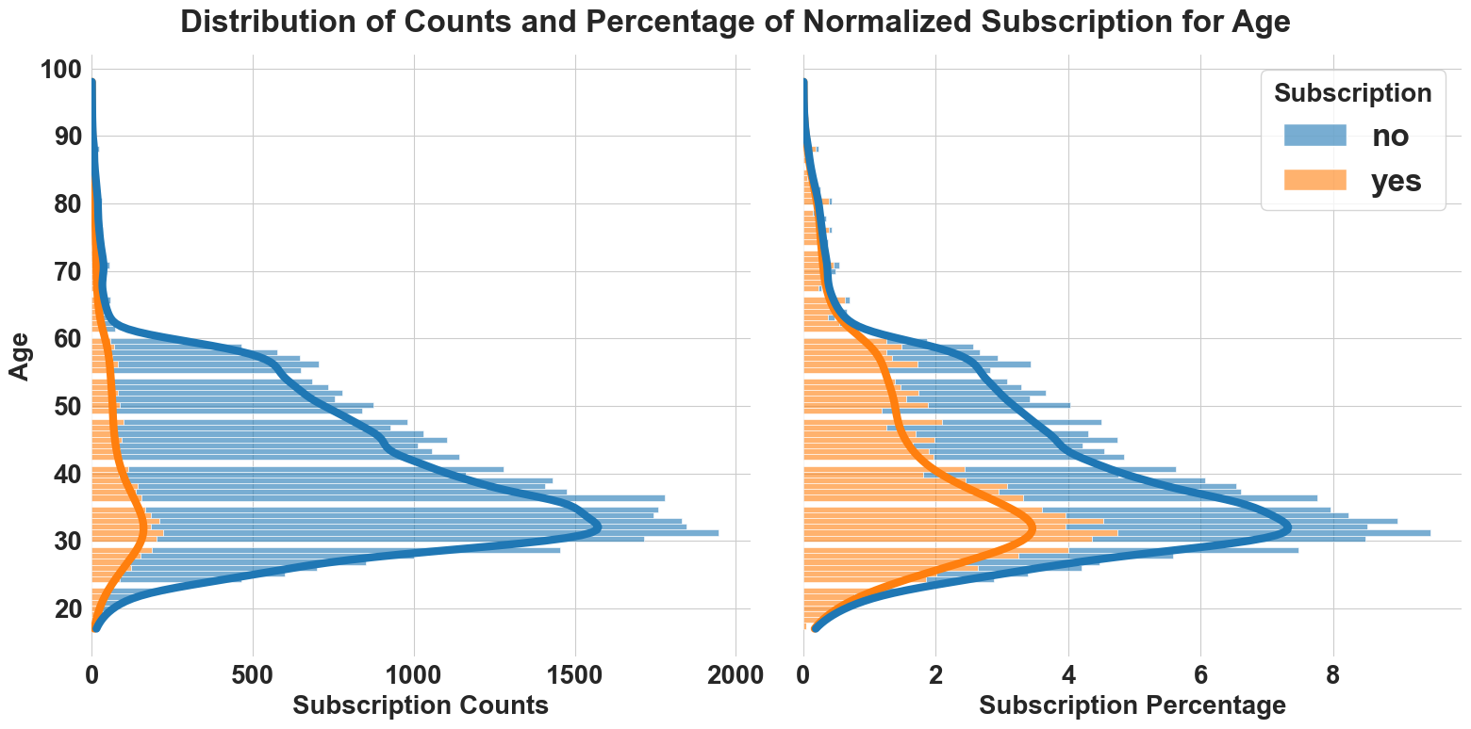
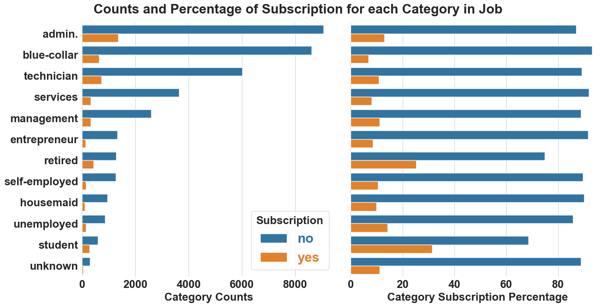
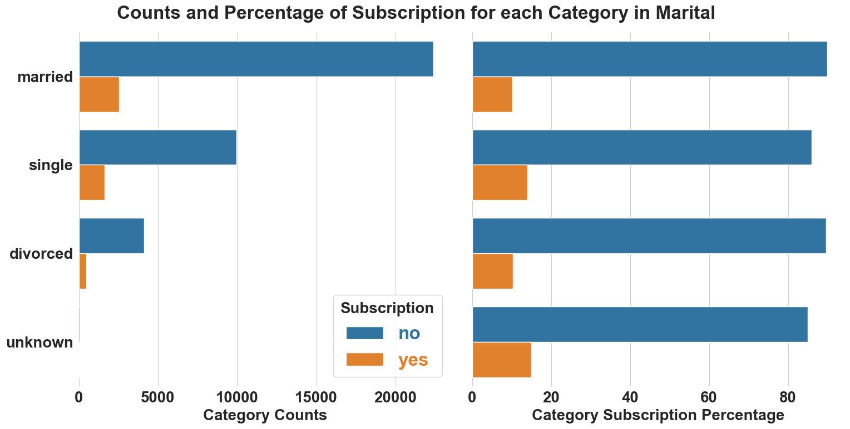
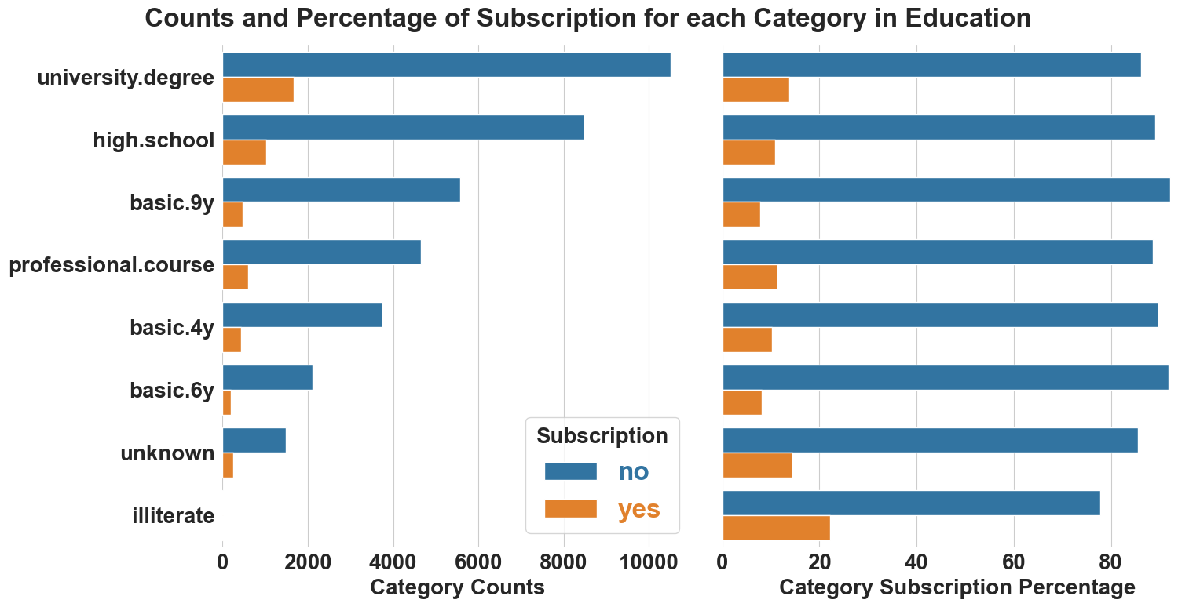
People over age of 60, retiree, single and with university degree are highly likely to subscribe to CDs

Slide 6
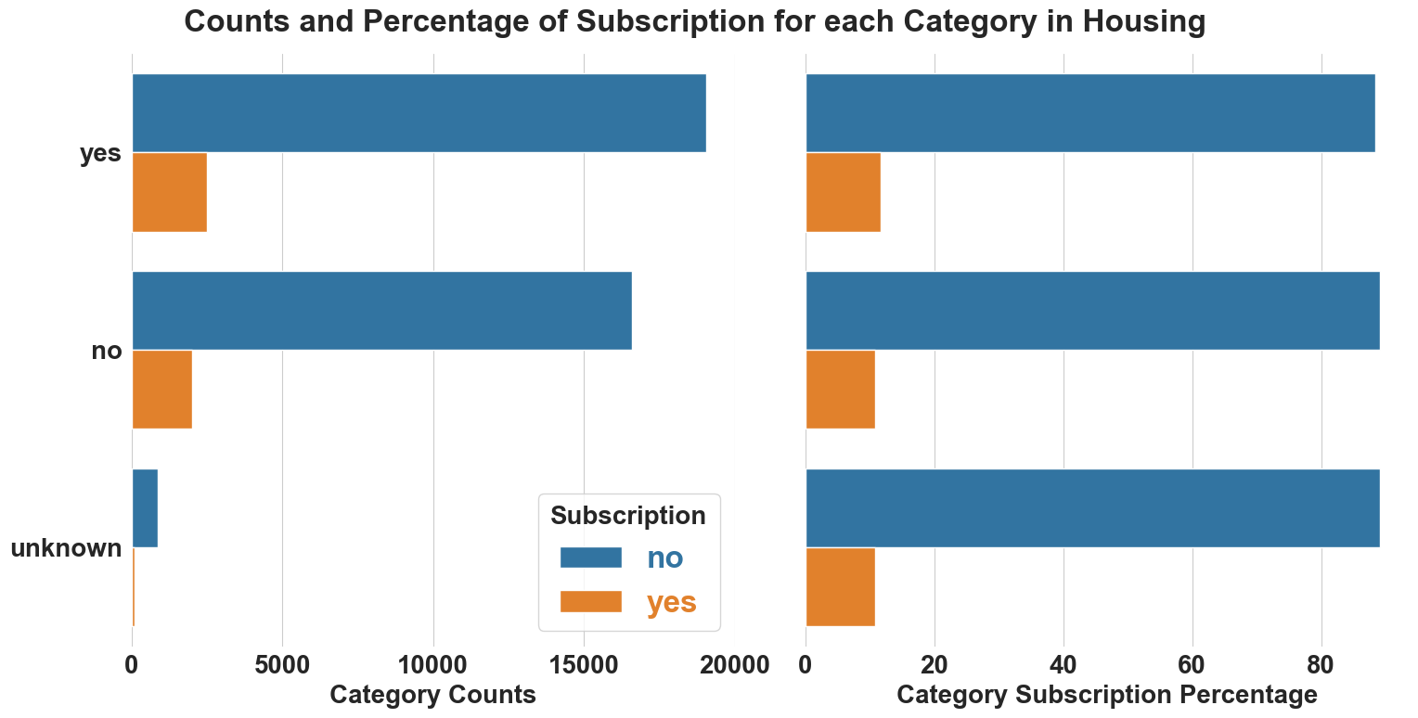
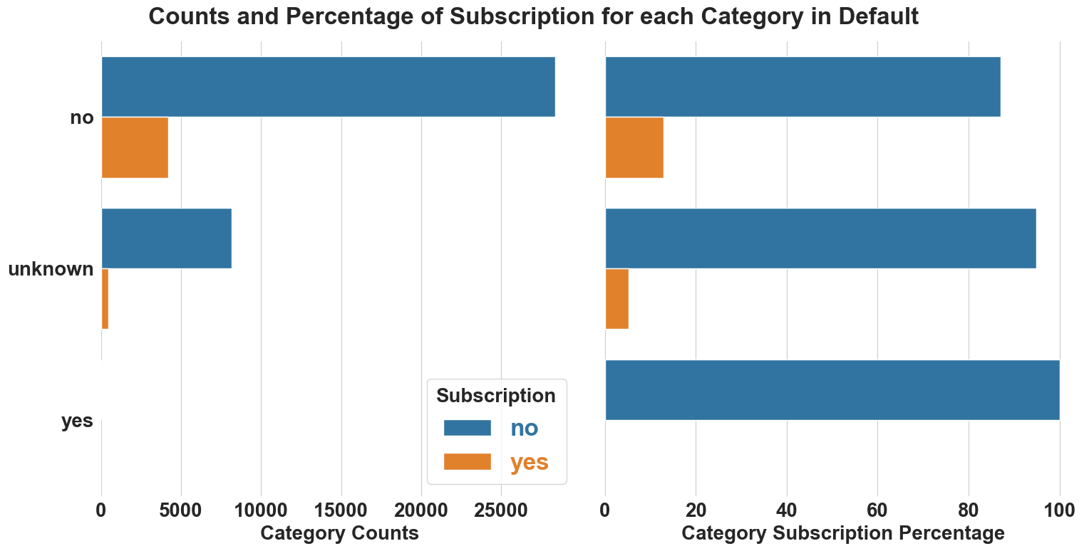
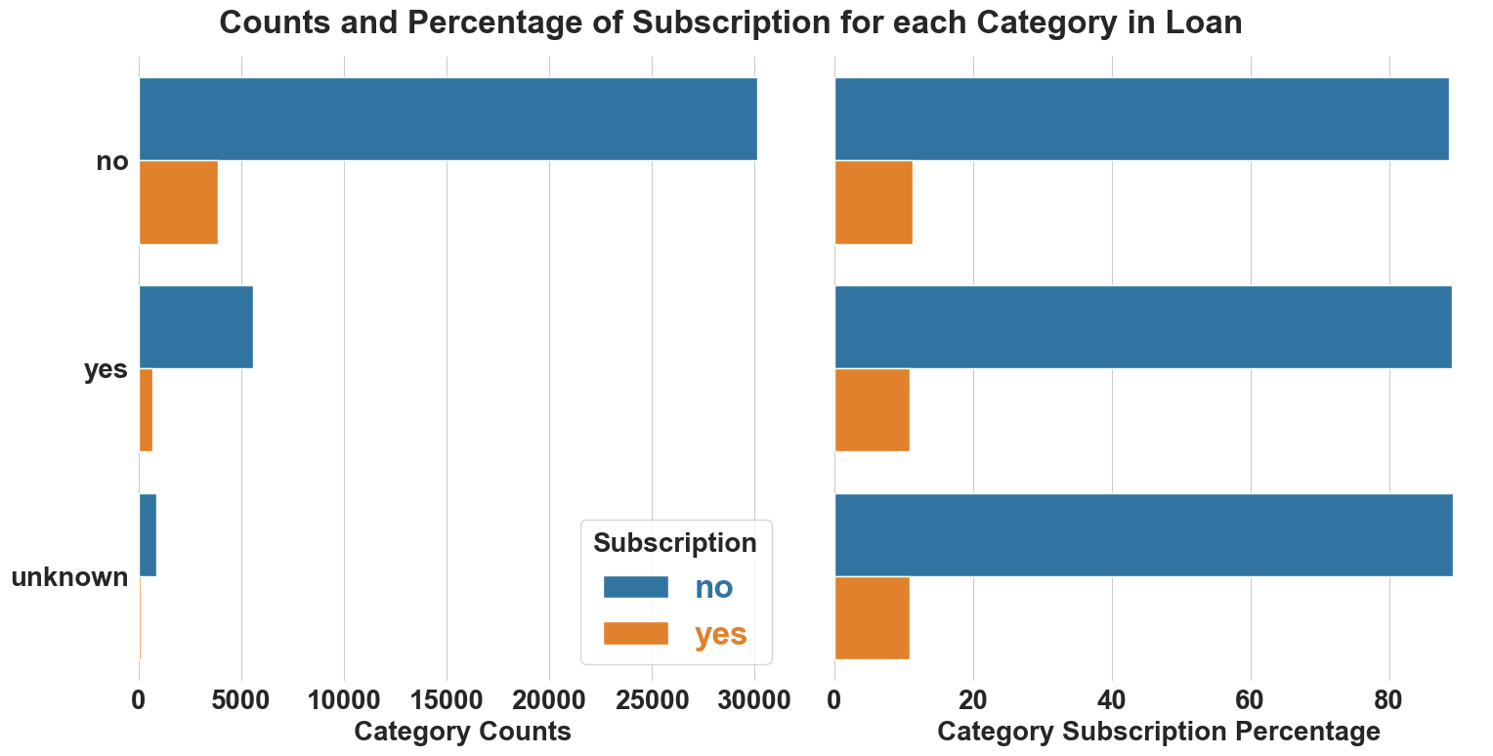
Housing and loan has no effect on CD subscription
Home ownership and loan status have no effect on CD subscription
Customers who have never defaulted are 3 times more likely to subscribe CDs compared to those who have defaulted or did not report their default status

Slide 7
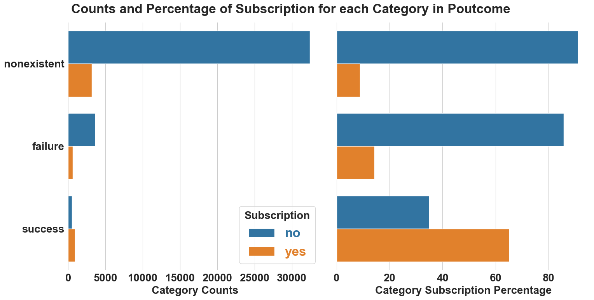
High retention rate: 65% of previous subscribers likely to subscribe CDs
Only 3.4% were successfully contacted before this campaign and over 65% of them subscribed to CDs, nonexistent means not contacted before this campaign

Slide 8
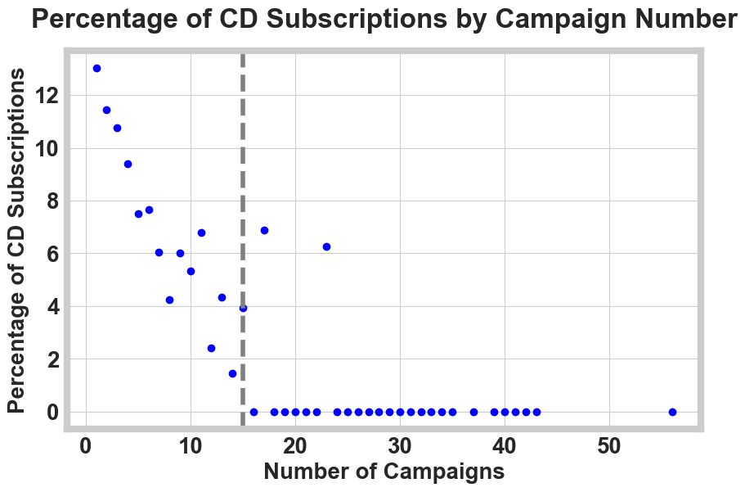
Subscription rate declines exponentially with number of calls
Subscription | No | Yes | Subscription Rate
Campaign
1 | 15342 | 2300 | 13.04
2 | 9359 | 1211 | 11.46
3 | 4767 | 574 | 10.75
4 | 2402 | 249 | 9.39
5 | 1479 | 120 | 7.50
6 | 904 | 75 | 7.66
7 | 591 | 38 | 6.04
8 | 383 | 17 | 4.25
9 | 266 | 17 | 6.01
10 | 213 | 12 | 5.33
11 | 165 | 12 | 6.78
12 | 122 | 3 | 2.40
13 | 88 | 4 | 4.35
14 | 68 | 1 | 1.45
15 | 49 | 2 | 3.93
17 | 54 | 4 | 6.90
23 | 15 | 1 | 6.25

Slide 9
Infrequent sub-categories were merged and mutated
Job sub-categories - unknown, student, unemployed and housemaid - each occurring less than 3% have been merged into a new sub-category called ‘Others’
The ‘unknown’ sub-category in Marital has been imputed with the most frequent sub-category ‘married’
Housing, loan and default features: Infrequent sub-categories were imputed
Education: Sub-categories occurring less than 5% in education were merged into a new sub-category called ‘Others’

Slide 10
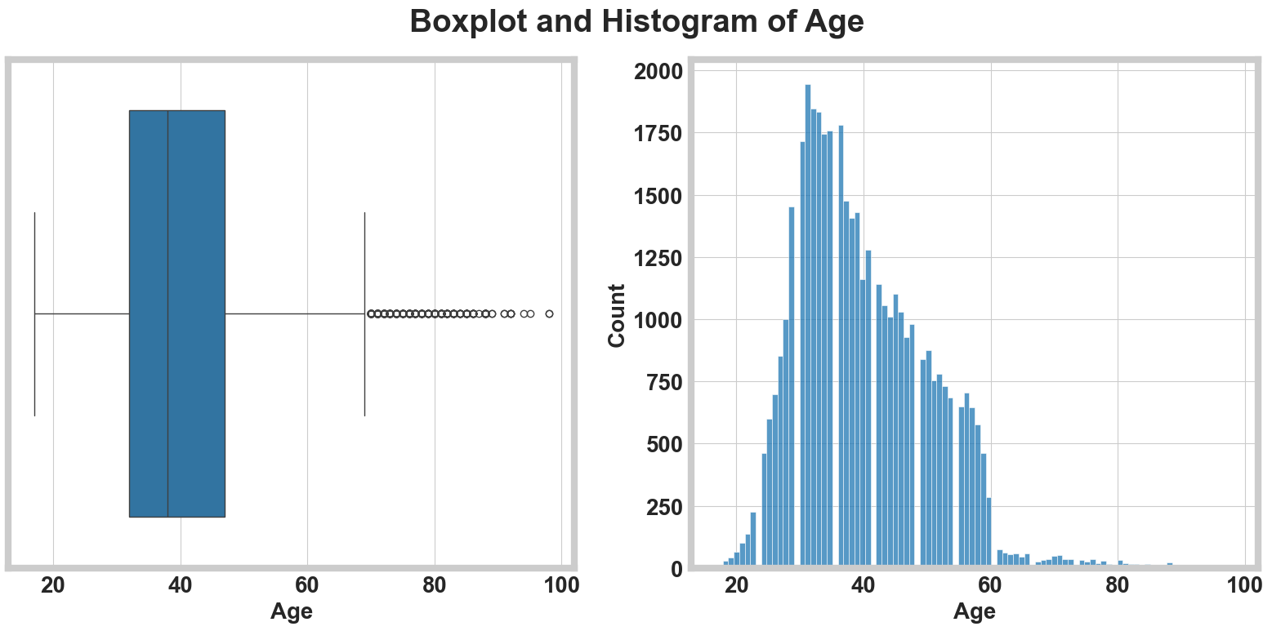
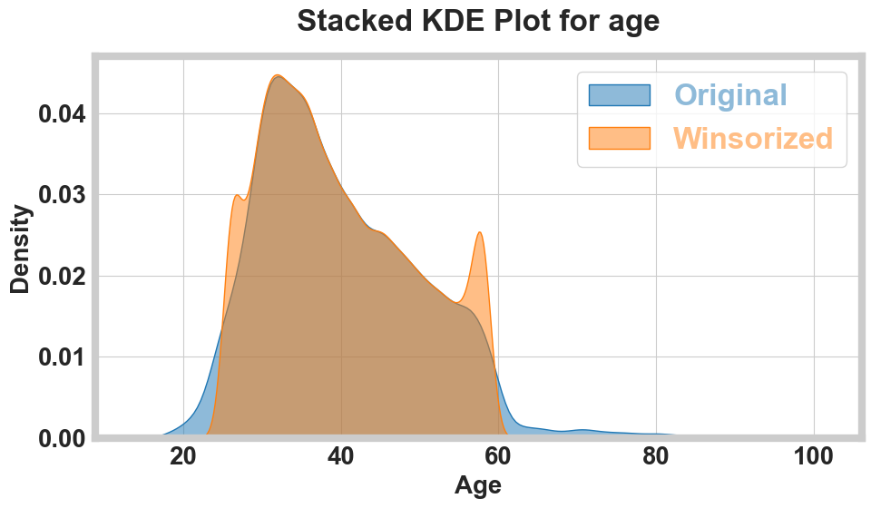
The distribution of numerical features remain unchanged after handling outliers using Winsorization method
Wilcoxon rank-sum test for age:
U Statistic: 847937868.50
P-value: 0.9712
Inference: The distributions of age are not
significantly different (p >= 0.05)

Slide 11
Loan, housing, and day of week features were dropped
Cat. Features | Target | Cramér’s V | p-value | Deg. of Freedom
job | Subscription | 0.130368 | 1.3999e-147 | 8
marital | Subscription | 0.053683 | 6.222129e-27 | 2
education | Subscription | 0.067205 | 9.538740e-39 | 6
default | Subscription | 0.099097 | 3.624164e-90 | 1
housing | Subscription | 0.009860 | 2.529191e-02 | 1
loan | Subscription | 0.000000 | 3.747513e-01 | 1
contact | Subscription | 0.144626 | 1.452825e-189 | 1
month | Subscription | 0.274006 | 0.000000e+00 | 9
day_of_week | Subscription | 0.023180 | 2.981214e-05 | 4
poutcome | Subscription | 0.320411 | 0.000000e+00 | 2
quarter | Subscription | 0.109828 | 4.960959e-109 | 2
We dropped the months feature since we introduced the quarters feature, which had a Cramér’s V association of 0.99 with months. Additionally, months and poutcome had a Cramér’s V of 0.25, while quarters and poutcome had a Cramér’s V of 0.14
We dropped the loan, housing, and day_of_week features from predictive modeling due to their weak association with the subscription variable
For predictive modeling, categorical features were one hot encoded
Cramér’s V | Interpretation
V <= 0.1 | Weak association
0.1 < V <= 0.3 | Moderate association
0.3 < V <= 0.5 | Strong association
V > 0.5 | Very strong association

Slide 12
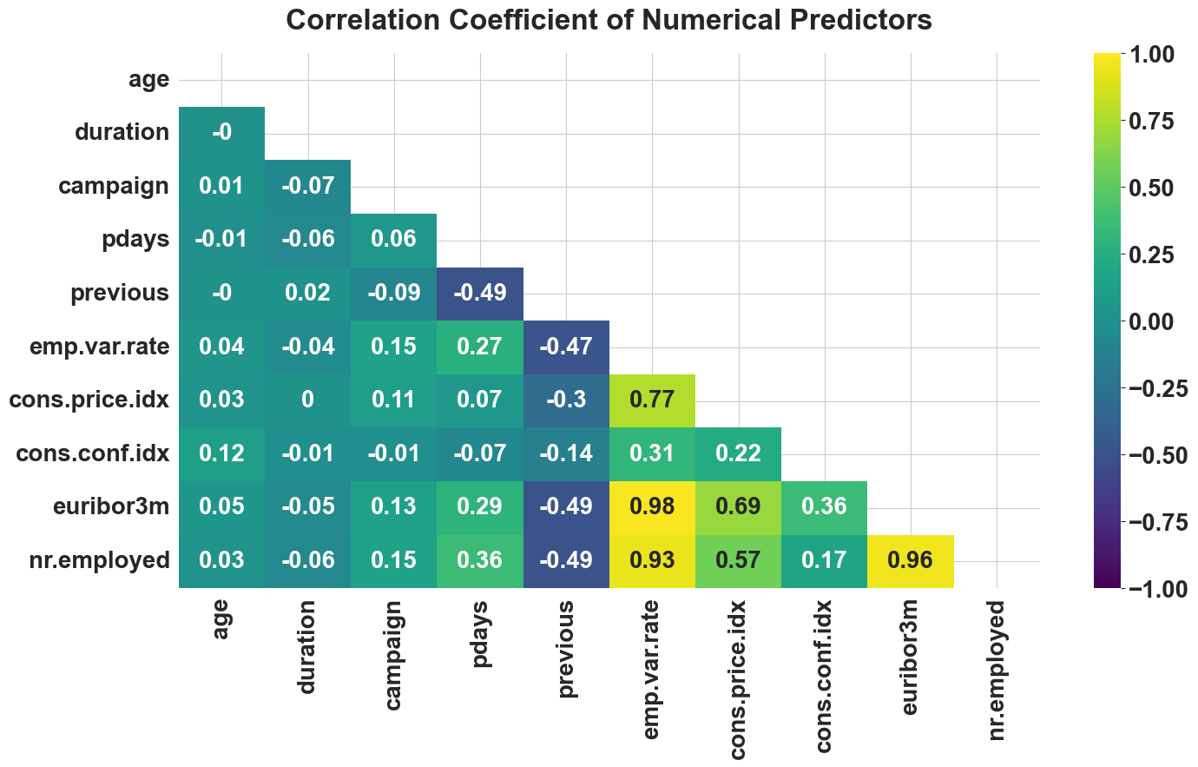
Highly correlated features with variation inflation factor over 5 were dropped
Feature | VIF
duration | 1.01
age | 1.01
campaign | 1.04
pdays | 1.45
previous | 1.60
cons.conf.idx | 2.89
cons.price.idx | 4.98
emp.var.rate | 34.87
nr.employed | 40.11
euribor3m | 68.19
These features were dropped

Slide 13
Class weight, up-sampling and threshold tuning were used to handle imbalanced data set
Our data contains 88.7% of customers do not subscribe to CDs, while 11.3% do. To address this imbalance, we employed several techniques:
Oversampling the Minority Class: We duplicated the minority class observations in the training dataset to balance it with the majority class
Class Weight Adjustment: We assigned higher weights to the minority class during model training
Threshold Tuning: The probability threshold for determining crisp labels was fine-tuned, rather than using the default threshold of 0.5
Models Trained
Logistic Regression
Random Forest Classifier
Support Vector Machine (SVM)
XGBoost Classifier
K-Nearest Neighbors (KNN)
Voting Classifier
Neural Network
Balanced class weight /scale positive weight from scikit-learn
Class weight optimization and up-sampling minority class for Neural Network

Slide 14
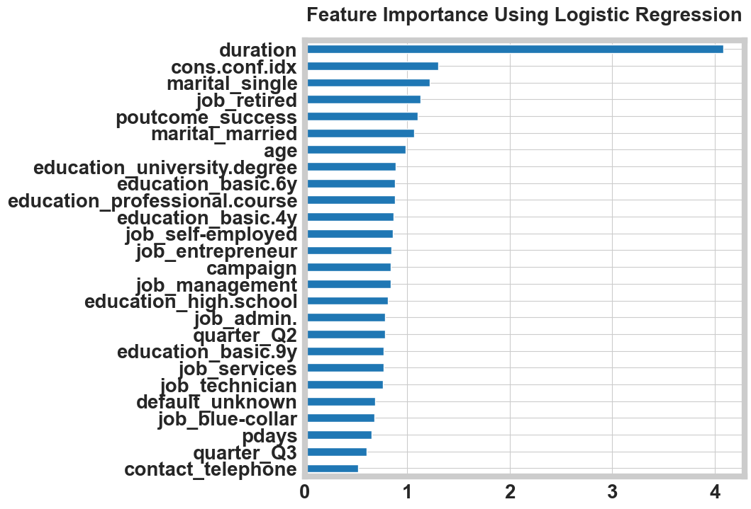
Logistic regression was used as a base model
Train Score: 0.838
Test Score: 0.837
Test F1-score: 0.527
Balanced class weight was used from scikit-learn library to handle imbalanced data
Call duration, consumer confidence index, job retired, previous outcome success and age were the most important features. This aligns well with our observation in exploratory data analysis

Slide 15
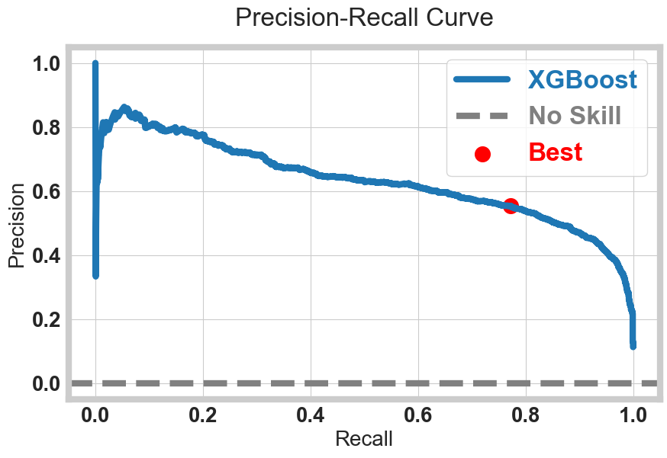
Threshold optimized XGBoost had a high recall and F1-score with better generalization to unseen data
Model | Train Score | Test Score | Train Precision | Test Precision | Train Recall | Test Recall | Test F1 Score | Test ROC AUC Score
Logistic | 0.8381 | 0.8371 | 0.3934 | 0.3914 | 0.8051 | 0.8040 | 0.5265 | 0.9017
Random Forest | 0.8505 | 0.8488 | 0.4207 | 0.4160 | 0.8681 | 0.8478 | 0.5582 | 0.9238
SVM | 0.8453 | 0.8361 | 0.4149 | 0.3957 | 0.9099 | 0.8628 | 0.5426 | 0.9144
KNN | 0.9249 | 0.8970 | 0.7512 | 0.5704 | 0.4992 | 0.3468 | 0.4314 | 0.8363
XGBoost | 0.9539 | 0.9103 | 0.8501 | 0.6236 | 0.7170 | 0.5140 | 0.5636 | 0.9400
Hypertuned XGBoost | 0.9219 | 0.9109 | 0.6956 | 0.6333 | 0.5455 | 0.4964 | 0.5565 | 0.9447
Threshold-Tuned XGBoost* | 0.9219 | 0.9109 | 0.5710 | 0.5538 | 0.7883 | 0.7721 | 0.6623 | 0.9446
Hypertuned Voting Classifier | 0.9296 | 0.9001 | 0.6487 | 0.5467 | 0.8181 | 0.7082 | 0.6169 | 0.9354
Hypertuned Neural Network | 0.8157 | 0.7952 | 0.6123 | 0.3412 | 0.9045 | 0.8793 | 0.7303 | 0.4917
XGBoost, Voting Classifier and Neural Network were hyper-tuned using 5-fold Grid Search Cross Validation
The hyper-tuned XGBoost model achieved the best recall and precision, demonstrating strong generalization to unseen data. The optimized threshold was 0.29

Slide 16
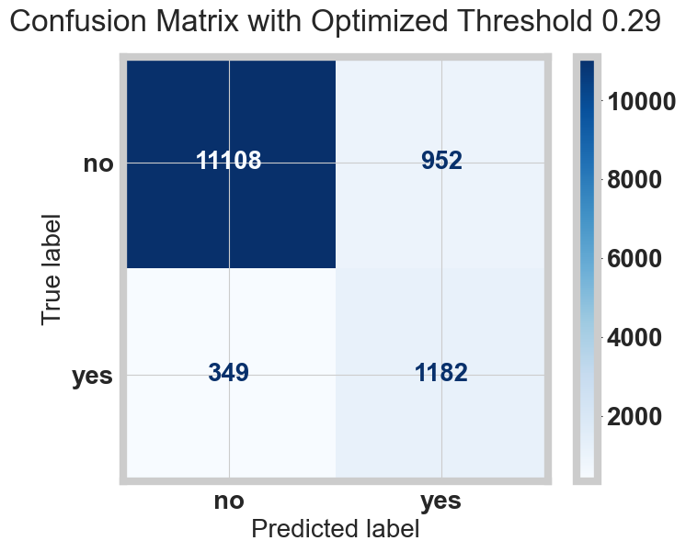
Identifying customers who will subscribe to CDs involves costs associated with targeting those who ultimately do not subscribe
The cost of missing a potential subscriber is higher, we prioritize recall to ensure we capture as many subscribers as possible
Optimized Precision (56.6%): Some marketing efforts on non-subscribers
Optimized Recall (76.2%): Reduce risk of missing potential subscribers
Maximized F1 Score (64.9%): Good balance between capturing subscribers and managing costs

Slide 17
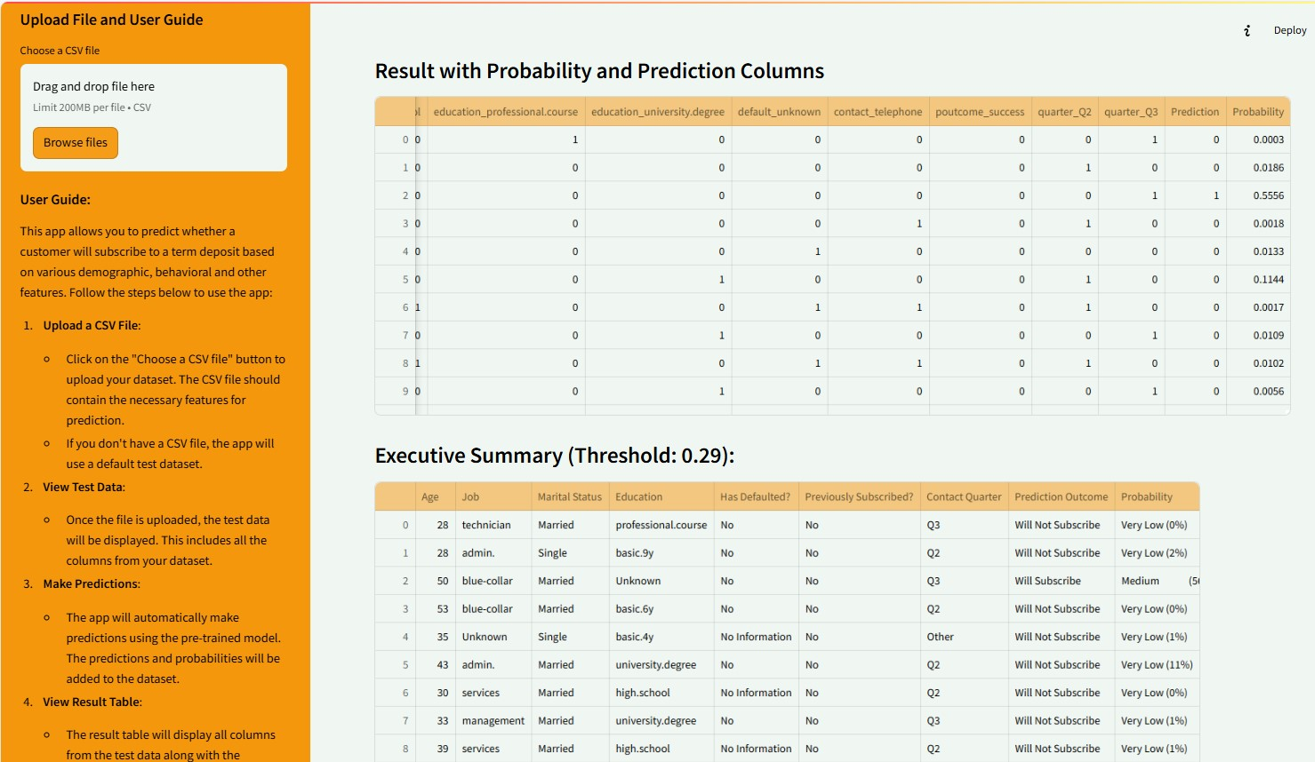
Model deployment and continuous monitoring on cloud using Streamlit app
Retrain model periodically based on business needs
Continuous monitoring of model predictive power
Use population stability index (PSI), Z-score etc. to make sure there is no model drift

Slide 18
Customer segmentation and tailored marketing strategies based on subscription probability
Tier 1: High Probability (0.8 - 1.0)
Personalized Offers: Tailor offers based on age, job, and education
Direct Communication: Use preferred contact methods.
Exclusive Deals: Highlight limited-time offers
Financial Advisory: Provide personalized advice sessions
Tier 2: Medium Probability (0.5 - 0.8)
Targeted Campaigns: Use digital marketing and mobile apps
Educational Content: Share videos and articles on CD benefits
Incentives: Offer bonuses or interest rate boosts.
Quarterly Promotions: Align with financial planning cycles
Tier 3: Low Probability (0.3 - 0.5)
Awareness Campaigns: Focus on CD safety and reliability
General Promotions: Offer introductory rates and flexible terms
Cross-Selling: Promote other banking products
Customer Engagement: Use surveys to understand needs

Slide 19
Future enhancements: Integrating additional data sources for improved CD subscription prediction and marketing strategy
Enhanced Data Integration: Incorporate client transaction history, investment activities, and savings account information to improve model accuracy
Behavior Forecasting: Better predict customer behavior, opportunity costs, acquisition expenses, and potential lifetime value
Investment Prediction: Analyze previous CD subscription data to determine how much a client might invest in a CD
Key Indicators: Identify trends from savings patterns, transaction histories, and investment activities
Personalized Marketing: Focus on customers with higher savings balances and frequent investment activities for larger CD investments
Lifetime Value: Understand the long-term value customers bring and optimize acquisition costs accordingly

Slide 20
Acknowledgements
I would like to extend my heartfelt gratitude to everyone who provided invaluable assistance during this project.
Vivian S. Zhang
Cole Ingraham
Vinod Chugani
Khuzaima Shahid
Jonathan Presley
Philippe Heitzmann
Kyle Gallatin
All my cohorts

